Slide 1

Crime Predictor
Team Members:
Amit Panda, Murtaza Dhuliawala, Niranjan Uprethi, Pulkit Sachdeva, Vivek George

Slide 2

The System
Analyze the crime data for the city of San Francisco over the last 12 years.
Visualize the trends in crime by rate of incidents, type of crimes in the different locations.
Build a model which, given time and place of crime, can predict the category of crime that has occurred as also the probability of a crime occurring in a given location at a given time.

Slide 3
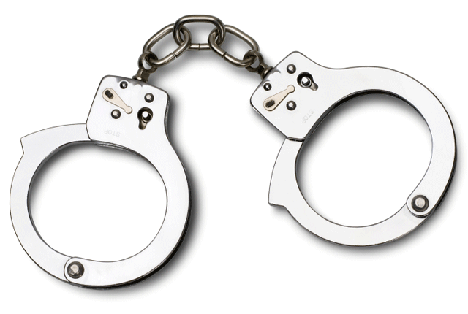
The big question !!!
This system is being built with an aim to provide a tool to the police departments, to better prepare for a criminal incident.
Officers can ask more relevant and pointed questions on receiving a 911 call if they have an idea of what crime may have occurred rather than relying on their gut feeling.
The interactive visualization would help administrators and police departments explore and understand trends in crime over the last twelve years.

Slide 4
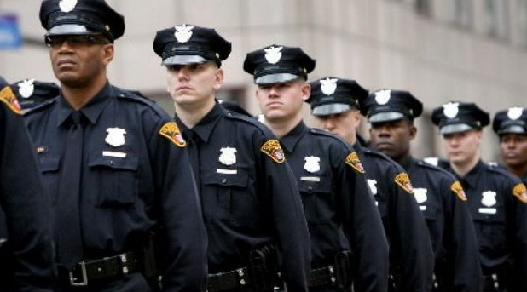

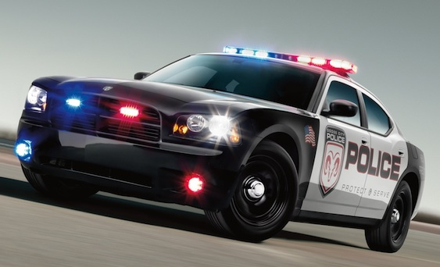
Make a difference
Predicting type of crime would help SFPD to be better prepared. To plan and have the resources available to deal with the crime.
The system could be used by civilians to get an understanding of areas that would be safer to live in, or areas that are unsafe to visit or pass-by at certain times.
Given a source of data, the system could be expanded to cover any major city in the world.
Other metrics like population density, income of people in an area, office buildings in a location could be used to draw more inferences on crime data.

Slide 5


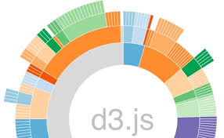
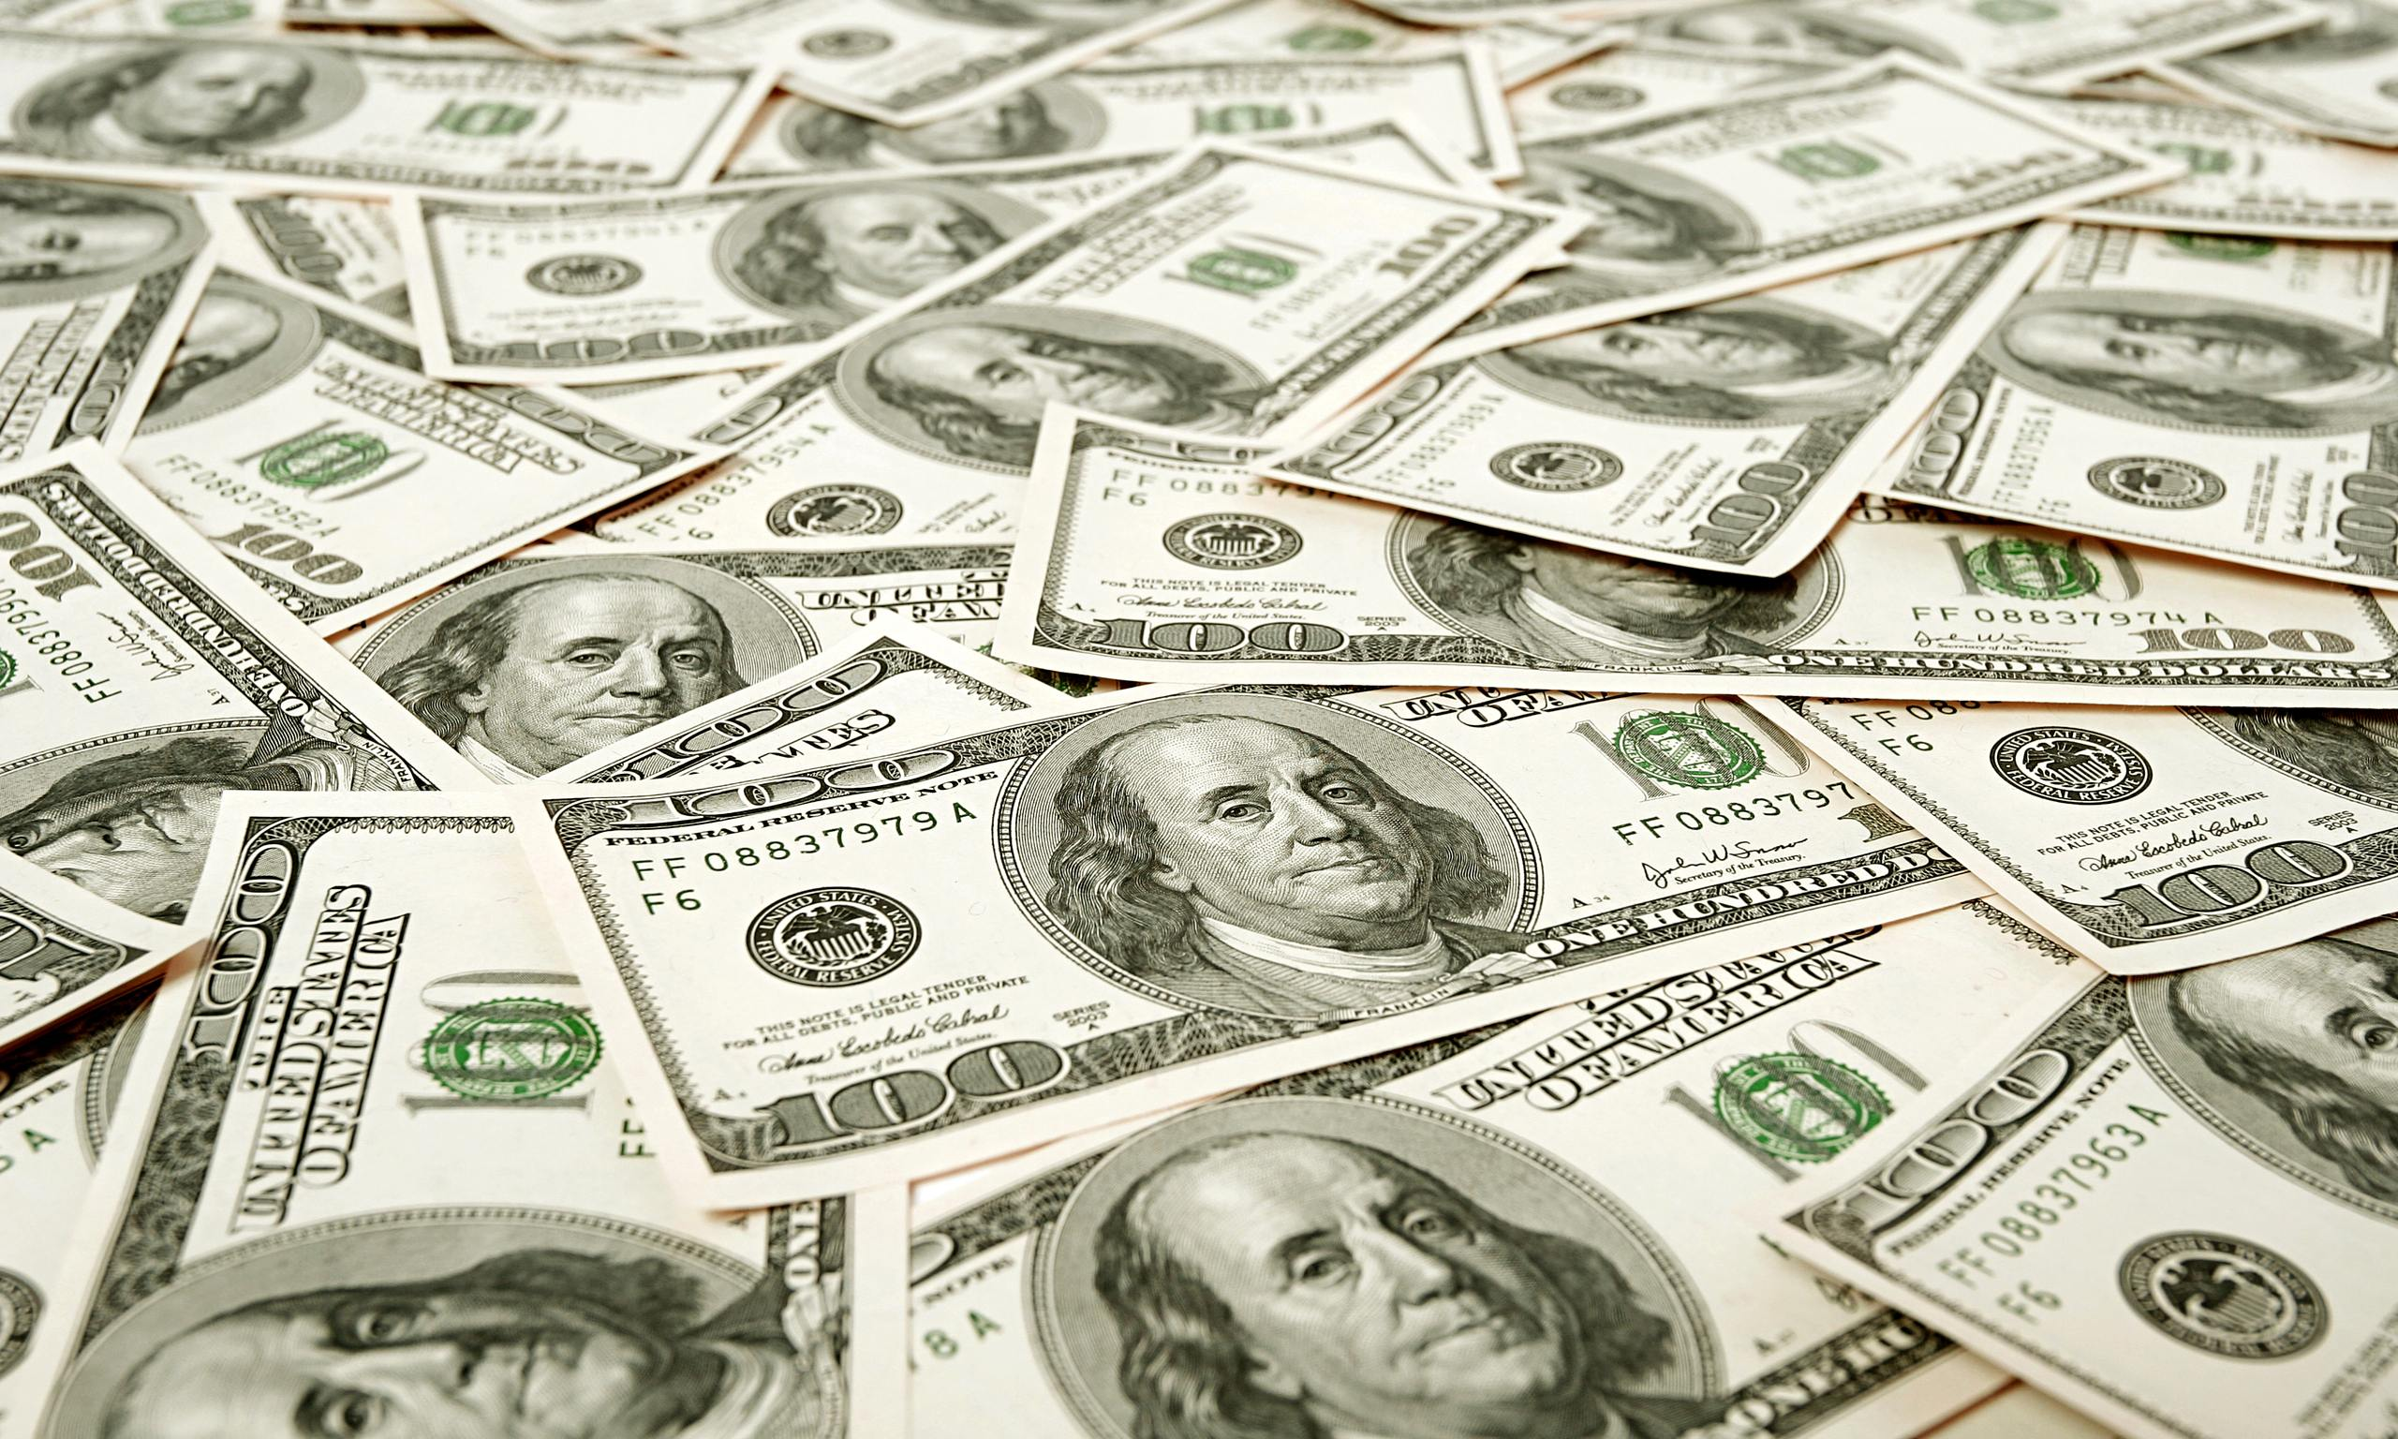
The risks and the costs
The risk is that there might be no relation between the area a crime happens in, the time it happens at and the kind of crime that happens, and the prediction accuracy might be very low.
The system will be built on open source technologies like D3, python, R. The data is clean and freely available on the SF Open Data and Kaggle website.

Slide 6
The plan – Goals for the next Month
Approximately two months completion time
Design visualizations and start implementation
Exploring different classification techniques
Start learning about various validation techniques
Test if other data sources (e.g. median income statistics from census data) improve classification accuracy
Design an application that works with real time data

Slide 7
Thank you

